Slide 1

The Virginia Tech Undergraduate Experience
Rachel Holloway, Vice Provost for Undergraduate Academic Affairs
October 28, 2024

Slide 2
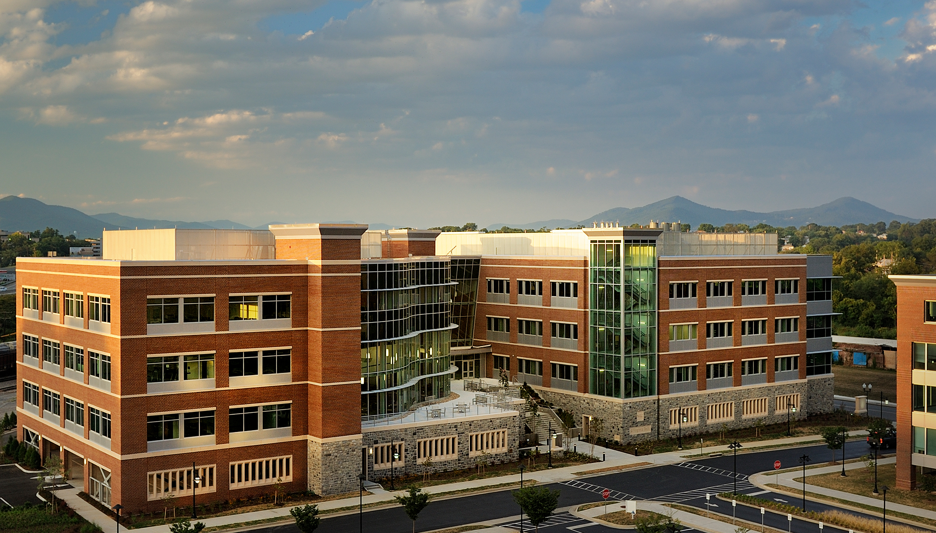

We envision a time when the full impact of
the land-grant promise informs and drives
the educational experience for all students.
Notes:
Undergraduate Academic Affairs adopted this statement from the Beyond Boundaries report as a vision statement, an inspiration, and a touch stone.
It challenges us to engage our students in the university’s mission, in the commitment to serve those beyond the university through our discovery, to embrace what has been articulated as the Ut Prosim Difference in our work.
It also calls us to account—
We must work to extend the full impact of the university, the special opportunities for learning and engagement created in a Research 1, land-grant, residential university context.
Not for a few or for some but for all of our students.

Slide 3

Virginia Tech Undergraduate Experience
Inclusive
Integrated
Interdisciplinary
Notes:
Virginia Tech offers a portfolio of undergraduate and graduate degrees representing the disciplinary breadth characteristic of a comprehensive, land-grant research university.
The university conferred more than 10,000 degrees in the last academic year.
Virginia Tech offered than 5000 courses and more than 11,000 course sections last year to provide the teaching and learning opportunities required across the degrees.
More than 2500 instructional faculty (inclusive of adjuncts and part-time faculty) delivered these courses.
The work of academic resource alignment is to identify opportunities for reallocation and realignment within the university’s teaching and learning environment to best serve students and the university’s mission.
We accomplish this through continuous improvement, resulting in ongoing, evolutionary change and periodically through an indepth review of academic resource allocation

Slide 4
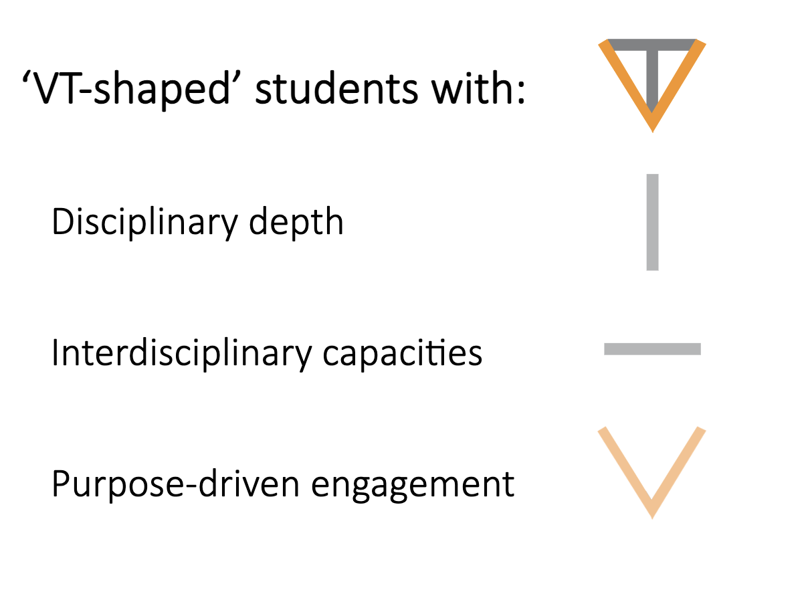
The VT Shaped Education

Slide 5
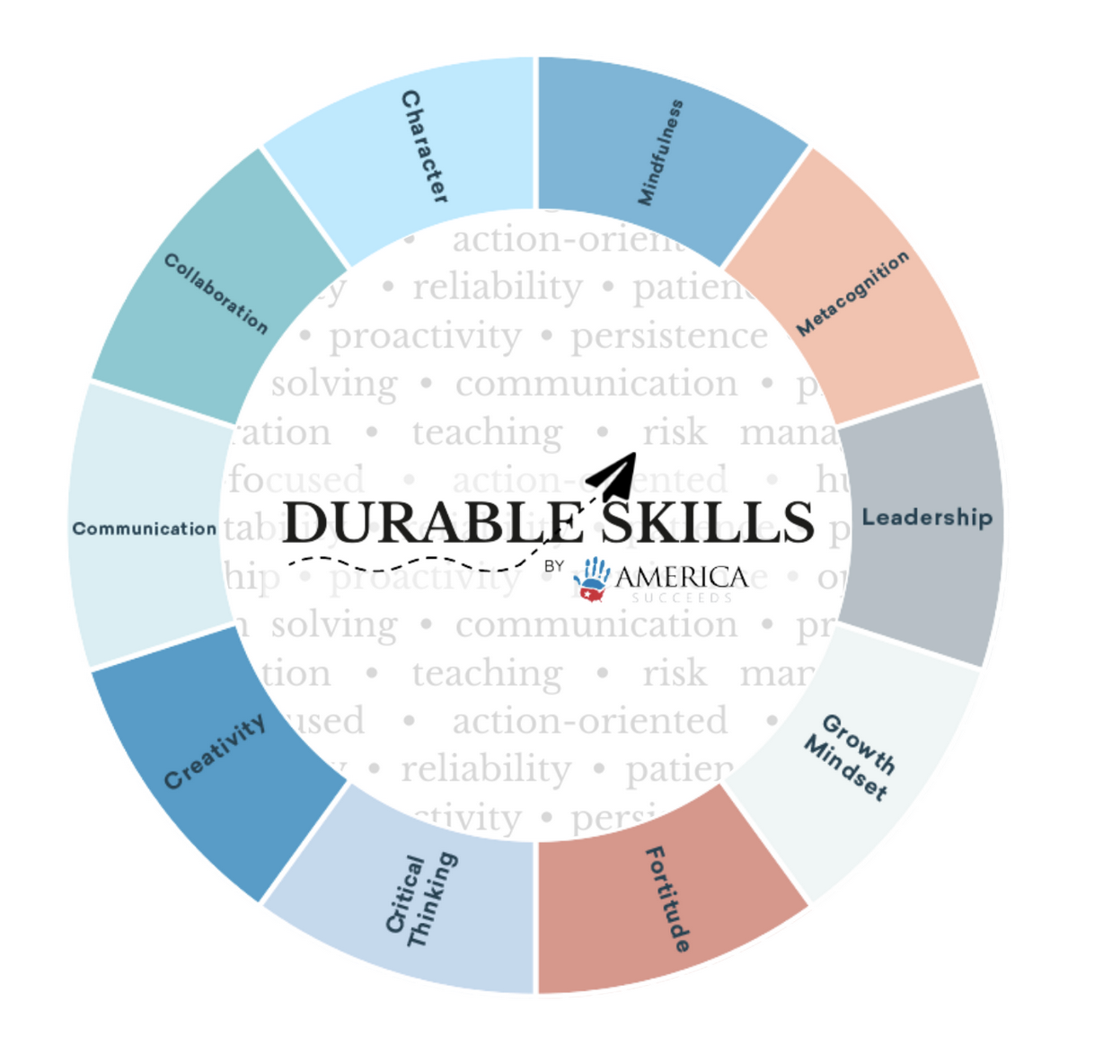
Disciplinary Depth and Durable Skills
Disciplinary Knowledge, Skills, and Abilities
Source: America Succeeds (https://americasucceeds.org/)

Slide 6
How do we ensure all Virginia Tech undergraduate students achieve a depth of disciplinary learning and sufficient competence in durable skills?

Slide 7
Curricular Structures
Pathways General Education
Degree Core
Major
    Option?
    Concentration?
Electives
Optional:
Second Major
Minor(s)

Slide 8
Define each of the following.
Degree Core
Major
Concentration
Option
Minor

Slide 9


If we don’t have common definitions . . .

