Slide 1
Proposed revision of Policy 6305 – Satisfactory Academic Progress of Bachelor’s Degrees

Slide 2
Initiated by the Commission for Undergraduate Studies and Policies
Prepared by the Academic Policies Committee
Discussed with CUSP, Academic Deans, College Directors of Advising, and the Advising Network
Presented to Faculty Senate Cabinet on September 20, 2024
Incorporated feedback from Dr. Rachel Holloway, Vice Provost for Undergraduate Academic Affairs, and Rick Sparks, University Registrar

Slide 3
Goals of the revision
Virginia Tech’s strategic plan identifies timely degree completion as a university goal.
Provide students clear and consistent degree progression standards across departments and colleges;
Provide a framework for timely intervention and support for students who may not be progressing toward a degree in a timely manner;
Remove unnecessary barriers to degree progression and completion that increase the cost of an undergraduate education

Slide 4
Proposed revision of Policy 6305 – Satisfactory Academic Progress of Bachelor’s Degrees for Associate and Undergraduate Students

Slide 5
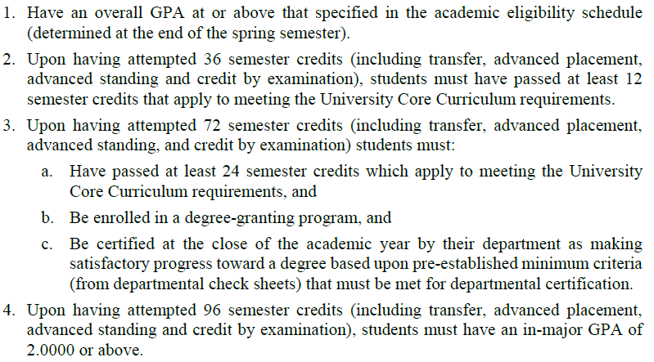
Section 2.1 – Continued Enrollment

Slide 6
Proposed Changes to Section 2.1
Upon having attempted 72 semester credits (including transfer, advanced placement, advanced standing, and credit by examination) students must:
a. Be enrolled in a degree-granting program, and
b. Be certified at the close of the academic year by their department as making satisfactory progress toward a degree based upon pre-established minimum criteria (from departmental program requirements) that must be met for departmental certification, and
c. Have an in-major GPA of 2.00 or above and maintain an in-major GPA of 2.00 or above until graduation.
In case of b or c, students will have one semester to get back into compliance. If they are still in violation after one semester, they will be asked to switch into a different major.

Slide 7
Section 2.1.1 – Other Policies
Section 2.1.1 allows colleges and departments to develop additional continued enrollment policies. However, no guidelines or restrictions are provided.
Our goals:
Departmental Progress to Degree statements need to align with university policies.
Departmental Progress to Degree statements need to align with graduation requirements.

Slide 8
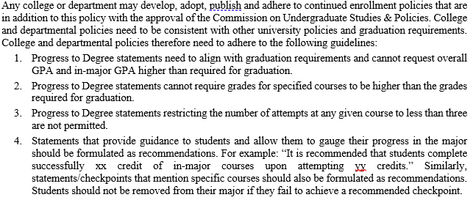
Proposed Changes to Section 2.1.1

Slide 9
Section 2.2 – Academic Eligibility
Students in Good Standing can take 19 credits in Fall and Spring, 18 credits in Summer, and 6 credits in Winter.
Currently:
“A student on probation may take no more than 16 credits per semester.”
16 credits is more than the average semester load of 15 credits needed to graduate in 8 semesters. The policy does not discuss Summer or Winter term for students on probation.

Slide 10
Section 2.2 – Academic Eligibility
Proposed change:
A student on probation:
• May take no more than 15 credits per major (Spring or Fall) semester;
• May not take more than 12 credits during the summer;
• May not take more than 3 credits during the winter

Slide 11
Section 2.3.2 – Credits from Other Institutions
Currently:
“A student may not receive credit for course work taken at another college or university during any period in which the student specifically has been suspended by Virginia Tech for academic and disciplinary reasons.”
Virginia Tech is an outlier here as many institutions allow students suspended for academic reasons to take course elsewhere and transfer the credits. We are not aware of any justifications for not allowing this at Virginia Tech.
Proposed: remove section 2.3.2
P.S. Students suspended for disciplinary reasons should not be allowed to receive credit for course work at other institutions.

Slide 12
Section 2.3 – Academic Suspensions
Academic Suspension is currently exclusively based on cumulative GPA.
For example, First Suspension is imposed when a student has two consecutive semesters with a cumulative GPA below 2.0.
This misses students who have a slow slide to suspension with multiple successive terms with unsatisfactory academic performances (term GPA below 2.0) while maintaining a cumulative GPA above 2.0.
The next two slides show two examples to illustrate the issue.

Slide 13
Student 1
Term | Term GPA | Overall GPA | Standing
Fall 2020 | 3.10 | 3.10 | Good Standing
Spring 2021 | 0.00 | 2.44 | Good Standing
Fall 2021 | 0.00 | 1.60 | 1st Academic Probation
Spring 2022 | 2.79 | 1.90 | 1st Academic Probation
Summer 2022 | 2.42 | 2.02 | Good Standing
Fall 2022 | 1.08 | 1.81 | 1st Academic Probation
Spring 2023 | 0.00 | 1.46 | 1st Academic Suspension

Slide 14
Student 2
Term | Term GPA | Overall GPA | Standing
Fall 2020 | 2.44 | 2.44 | Good Standing
Spring 2021 | 3.58 | 3.23 | Good Standing
Fall 2021 | 1.95 | 2.74 | Good Standing
Spring 2022 | Not enrolled
Fall 2022 | 1.33 | 2.47 | Good Standing
Spring 2023 | 1.13 | 2.25 | Good Standing
Fall 2023 | 0.00 | 1.77 | 1st Academic Probation
Spring 2024 | 0.00 | 1.51 | 1st Academic Suspension

Slide 15
Proposed Change to Section 2.3
Proposed new Section 2.3.2
2.3.2 Suspension Based on Consecutive Fall or Spring Semesters with Unsatisfactory Academic Performances.
Suspension will also be imposed when a student has two consecutive semesters (Fall and Spring) with a term GPA below 2.00. A student who is placed on suspension because of consecutive terms with unsatisfactory academic performance at the end of a Fall or Spring semester will be suspended from continued enrollment through the end of the subsequent Spring or Fall semester. A student must earn a minimum 2.00 term GPA the first semester back. Failure to meet this GPA criterion upon return will result in suspension through the end of the subsequent Fall or Spring semester.

